Slide 1
Virtual Fly Brain Web Resource & API
David Osumi-Sutherland - EMBL-EBI

Slide 2
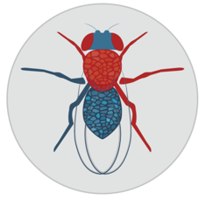

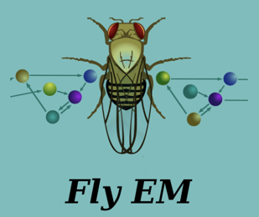
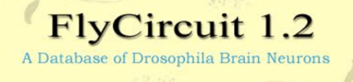
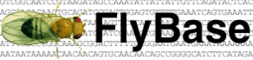
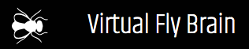


VFB data/metadata integration
Individual lab datasets
CATMAID

Slide 3
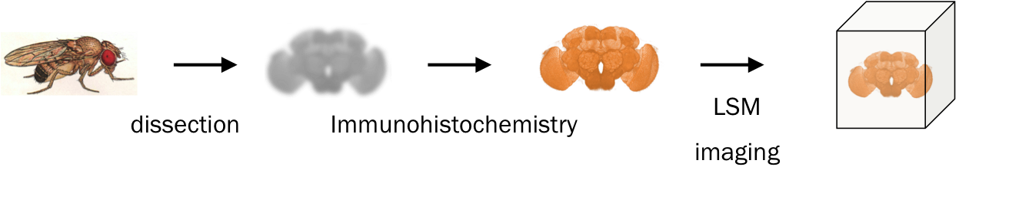
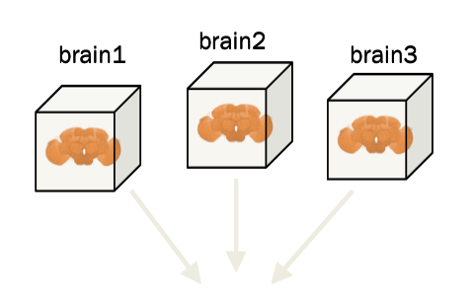
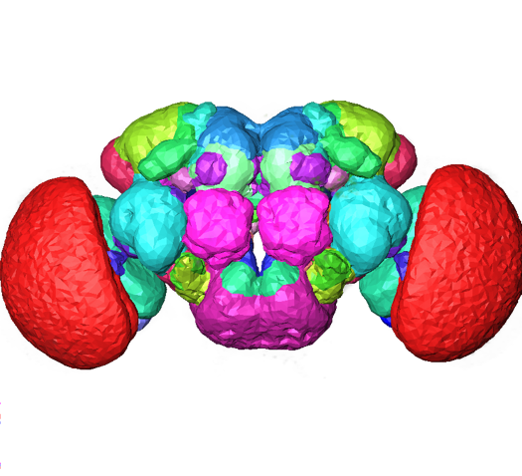
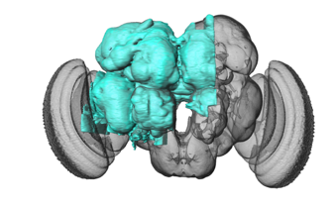
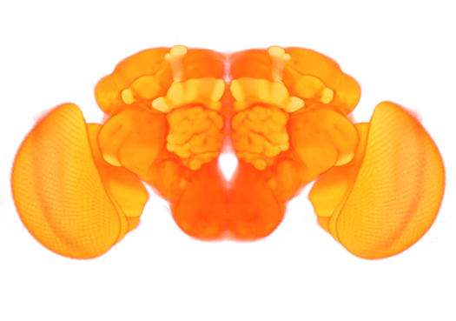
Image – based data integration
EM volumes
Standard parcellation
Template Brain

Slide 4
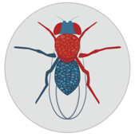

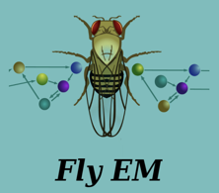

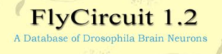


The nomenclature problem
Given that different resources/papers use different names for neuron types/classes (DA1_vPN; GABAergic) how can we cross query resources?
Individual lab datasets
CATMAID

Slide 5
Drosophila Anatomy Ontology (neural component)
What is it?
A curated, query-able classification of Drosophila neurons and neuroanatomy covering all stages of development
Standard nomenclature with symbols, synonyms and references for all terms
Composition
8637 neuron types
4,937 curated from 631 papers
3,734 provisional types (from hemibrain)
1374 nervous system regions
~17k queryable statements about neuron location, Innervation, fasciculation; synaptic connections; lineage; function

Slide 6
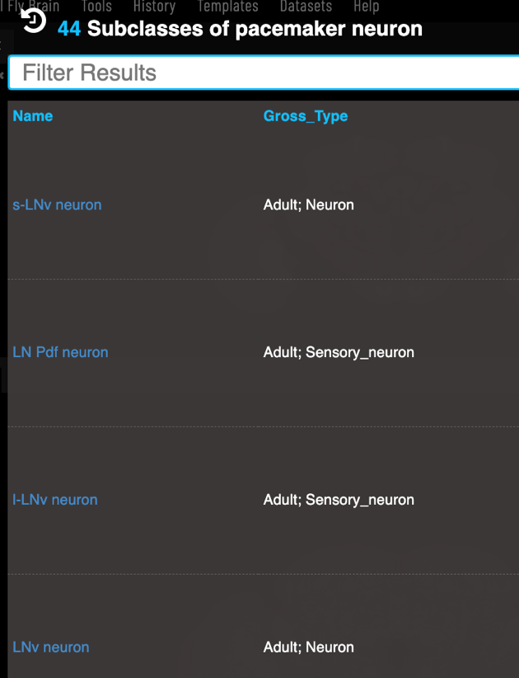
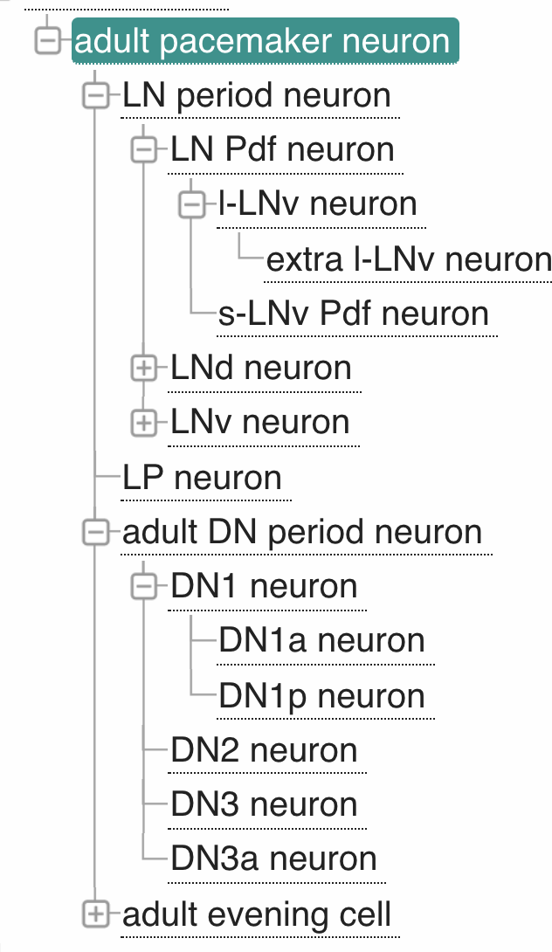
VFB knows about lots of types (classes) of pacemaker neuron & their classification relationships

Slide 7
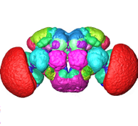
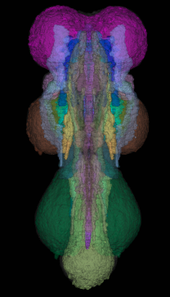
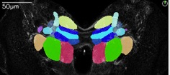
VFB semantic integration: we use the DAO to annotate
Images (~117k)
~ 67k single neuron images covering ~5k types, ~24.7k with associated connectomics data
>900 nervous system regions
~48k images of expression patterns covering 17k drivers
~4.7k images of 602 split combinations
Connectomics
~3.5m synaptic connections between ~24.7k neurons (From CATMAID & Neuprint)
Where drivers are expressed
~3,7k expression patterns: ~27.6k statements about expression in 1.7k neuron types
890 split combinations: ~2k statements about expression in 464 neuron types
multiple stages
& regions
Notes:
All Neurons8637625Characterised Neurons4903625Provisional Neurons37341Emphasise

Slide 8
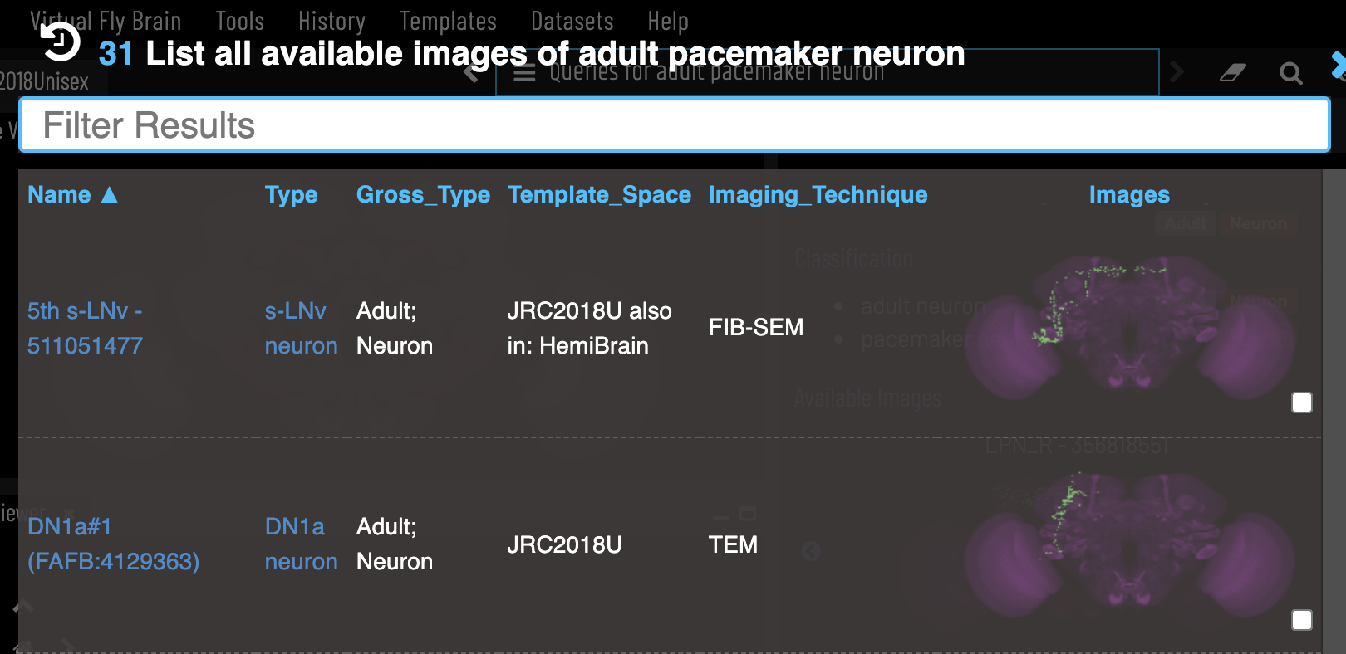
VFB has images and data for many individual pacemaker neurons (AKA instances), of different types & from different sources
Abstract classes are useful when searching for individual neurons

Slide 9
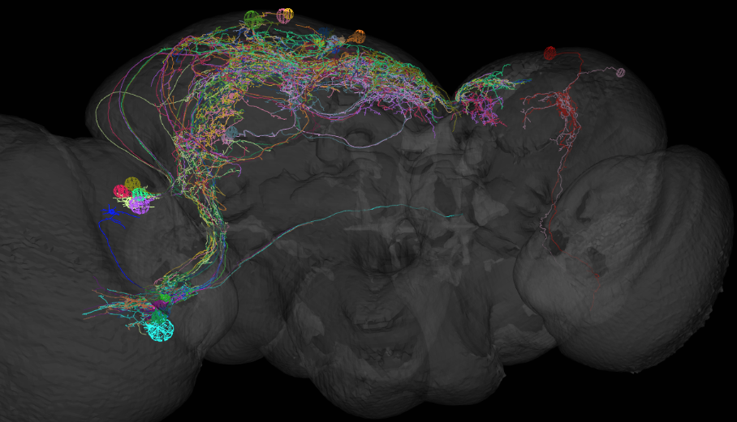
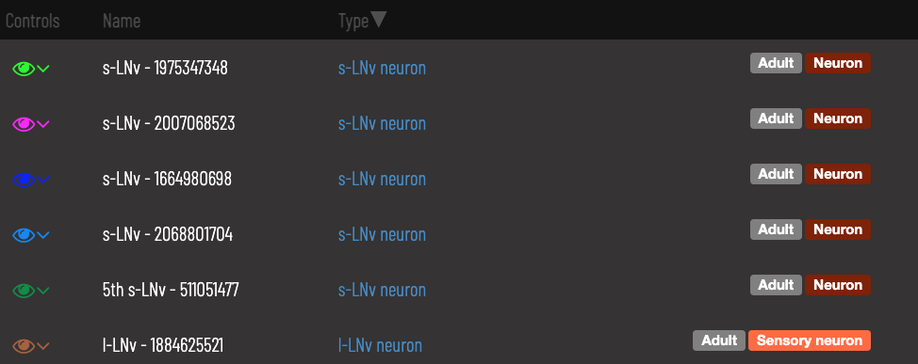

Slide 10
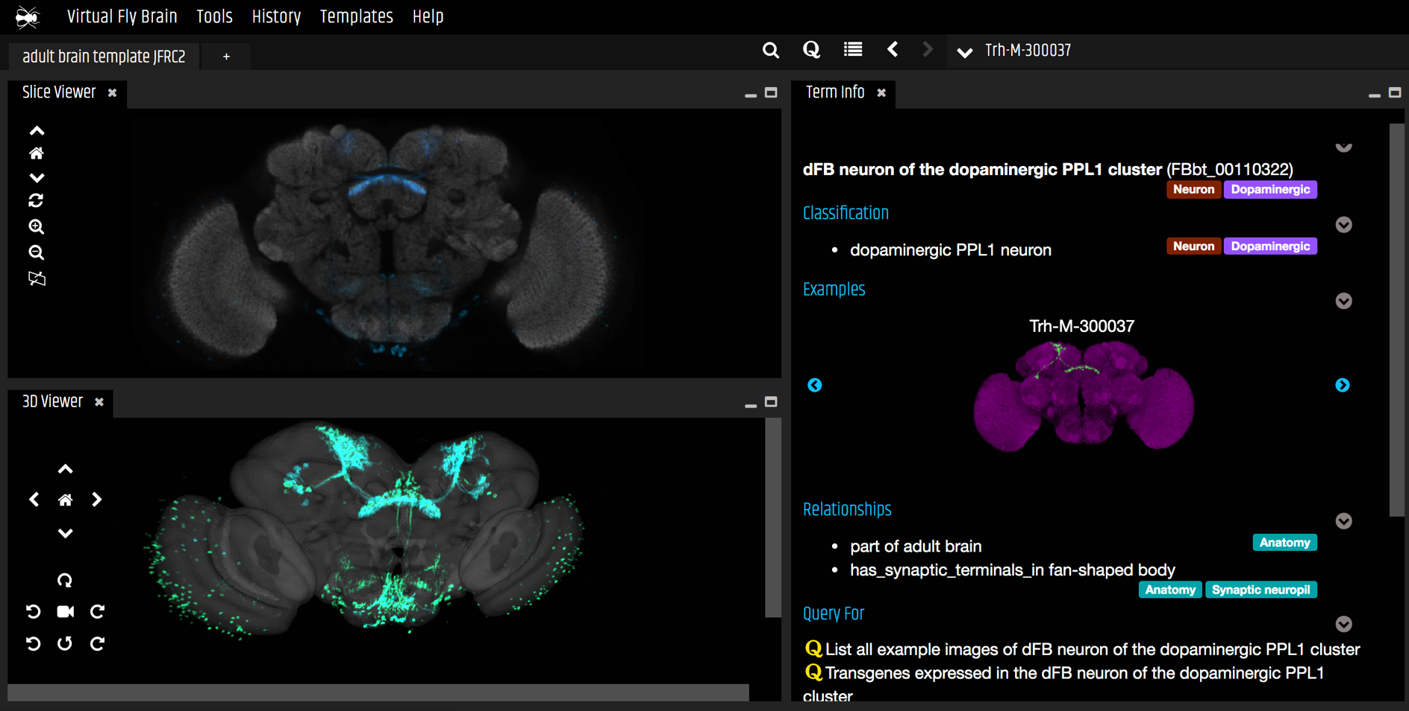
www.virtualflybrain.org

Slide 11

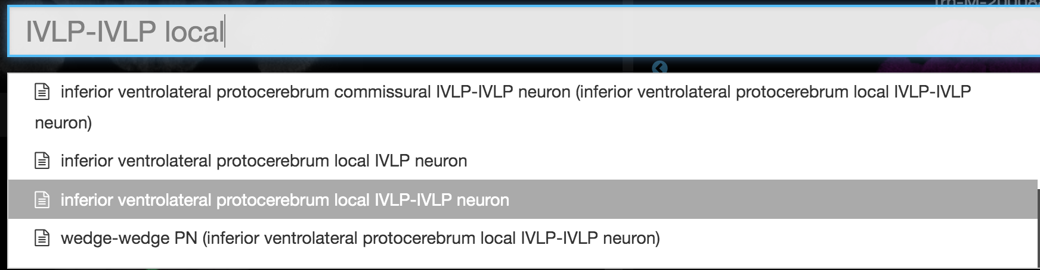
Search with any name from the literature

Slide 12
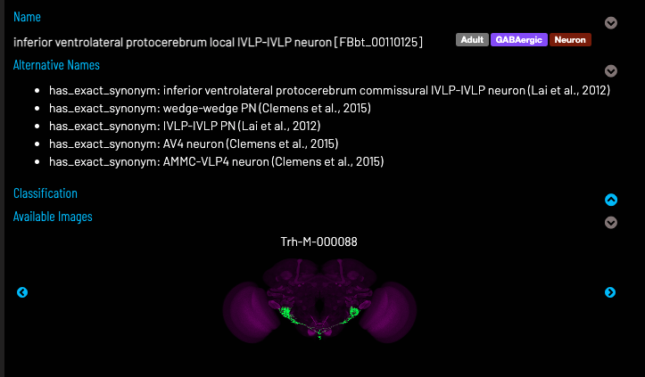
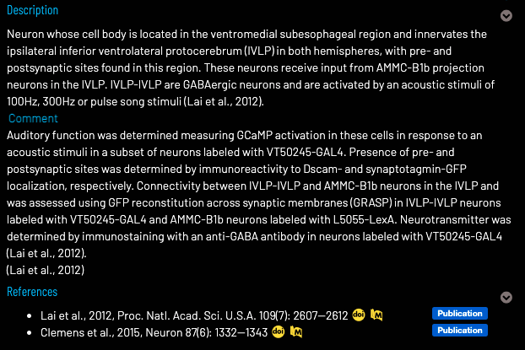

Slide 13
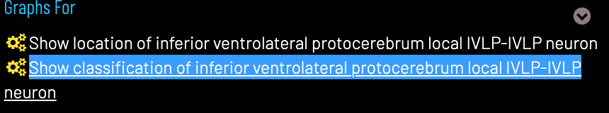
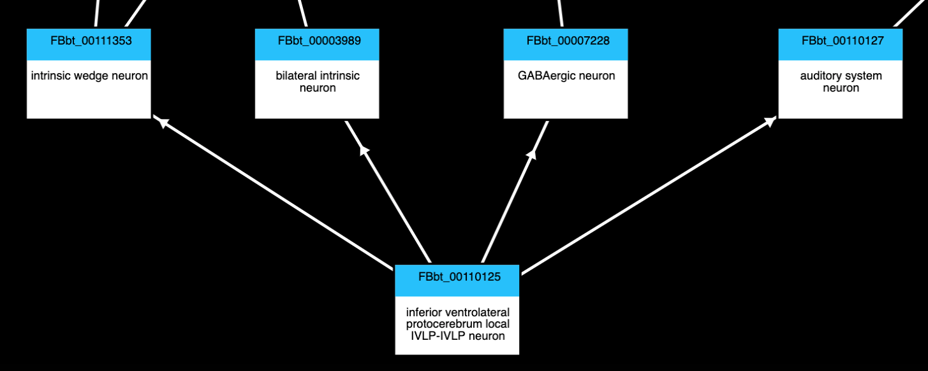
Browse to find more general terms

Slide 14
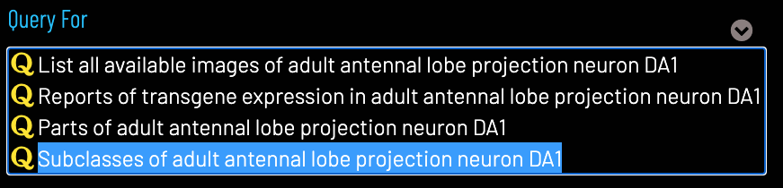
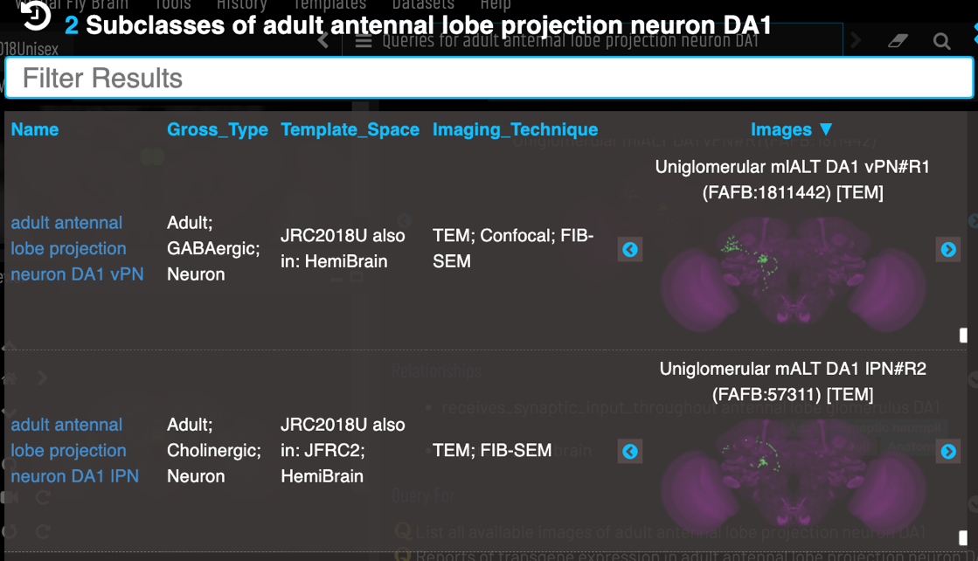
Query for more specific terms

Slide 15
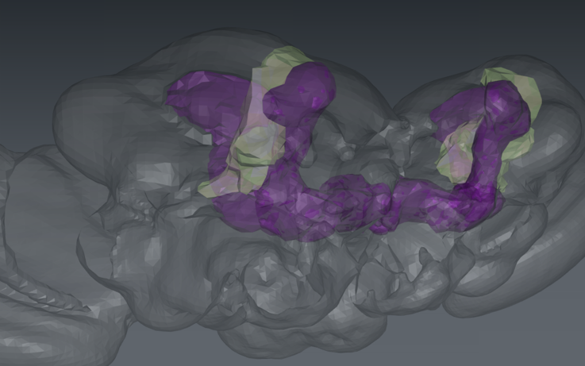

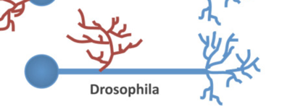
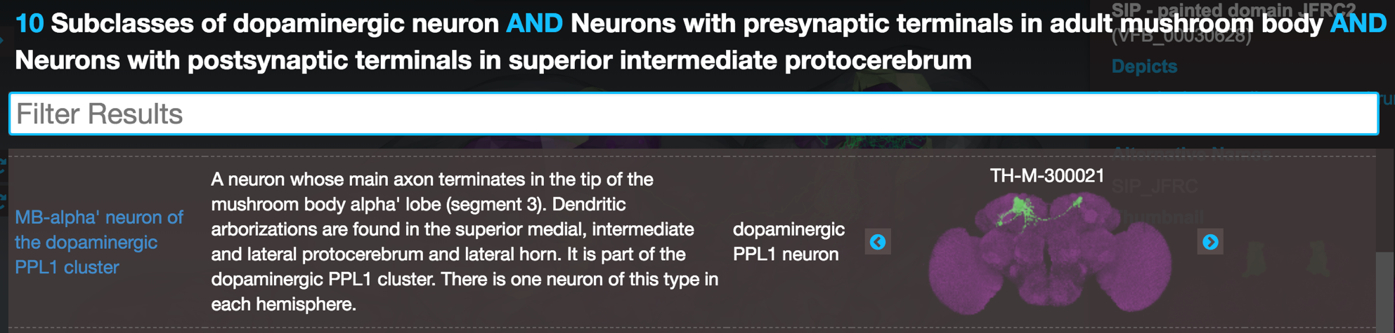
VFB queries
superior
intermediate
protocerebrum
mushroom
body
*
dopaminergic neuron
standard terms for annotating data
* Splindler & Hartenstein 2011 DOI10.1186/1749-8104-6-16
Notes:
Add images of neuropils once these are live.

Slide 16
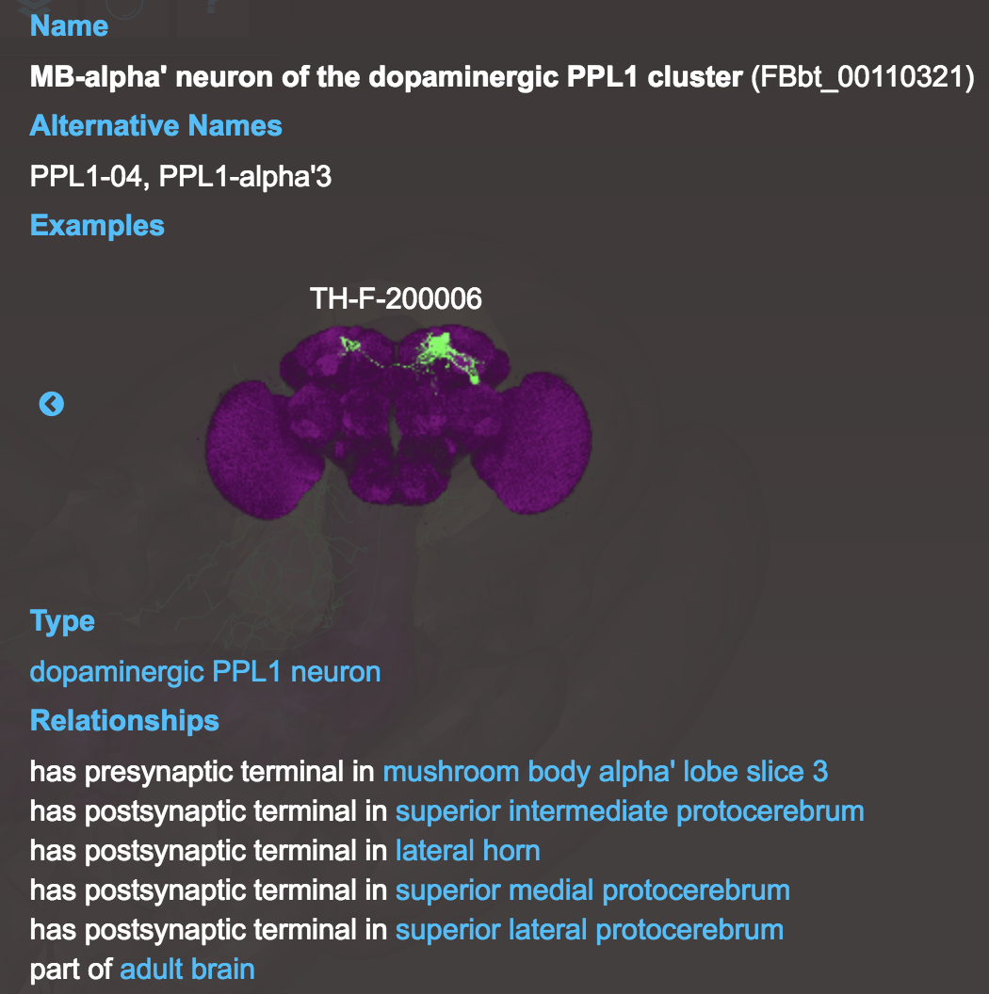
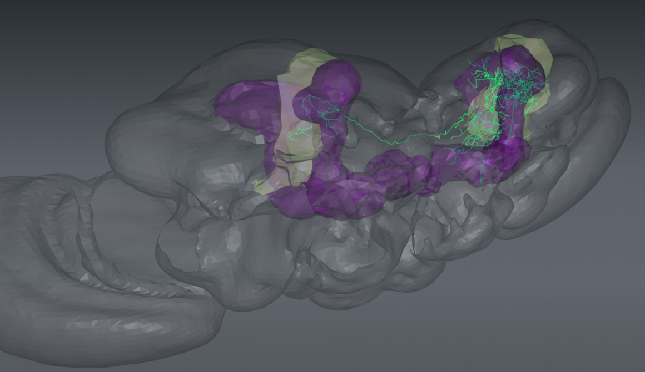
Query finds neurons with
Presynaptic terminals in parts of
the mushroom body

Slide 17
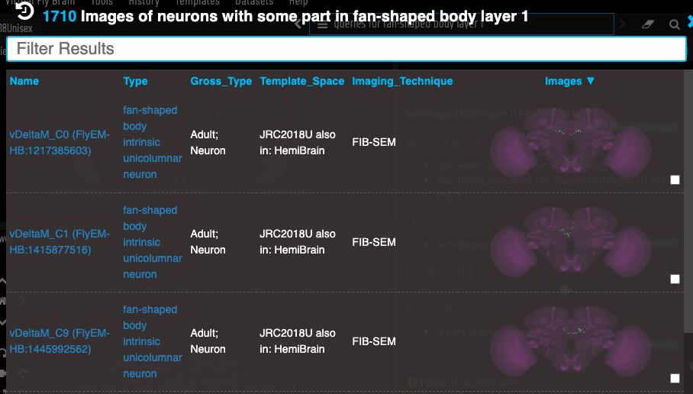

Slide 18
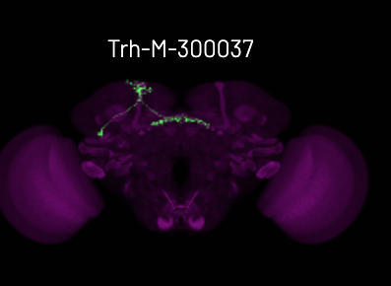
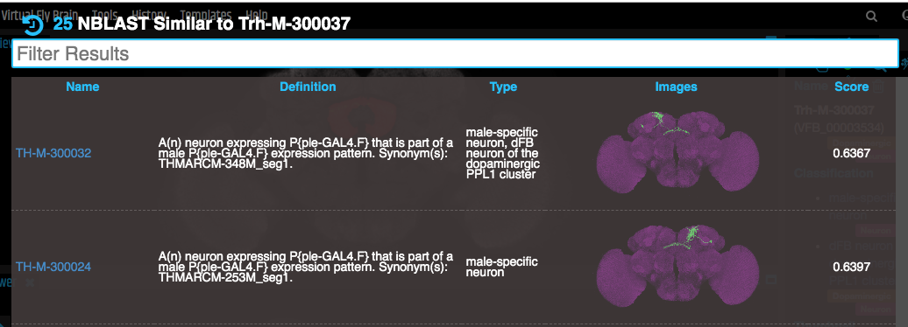
NBLAST – find neurons by morphology

Slide 19


Facilitating programmatic usage
API
API
API
Individual lab datasets
API
Use data directly from VFB, or use VFB to connect APIs to query data provider sites

Slide 20
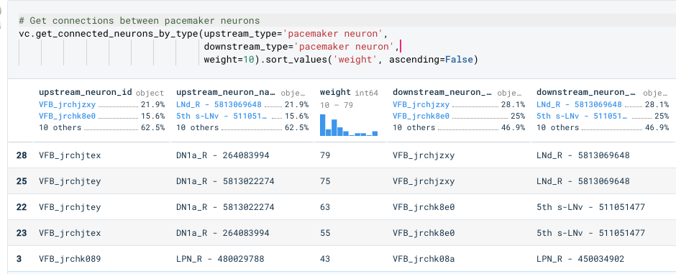
The abstraction provided by the class graph is useful for connectomics queries

Slide 21





Acknowledgments
WT105023MA
Virtual Fly Brain Project
David Osumi-Sutherland, Robert Court, Marta Costa, Clare Pligrim, Aoife Larkin, Gillian Milburn, Alex McLachlan, Nico Matentzoglu, Huseyin Kir, J. Douglas Armstrong, Greg Jefferis, Helen Parkinson, Cahir O’Kane
http://www.virtualflybrain.org

